Slide 1
Muhammad Talha Jamal (SP18-BCS-128) Samiya Ahsan (SP18-BCS-147)
Waddler
Supervisor Name: Dr. Assad Abbas
Department of Computer Science,
COMSATS University Islamabad.

Slide 2
Topics
Introduction
Overall Description
Project Scope
Modules
System Limitation
Software Process Methodology
Tools and Technologies
Work Division
Requirements Identifying Technique
Functional Requirements
Non-Functional Requirements
External Interface Requirements
Conclusion

Slide 3
Introduction
Our platform will be an mobile application that will provide a secure system to the waddler center through face recognition, where only registered faces can pick the child from the care center.
This platform’s main purpose is to help those parents who cannot give best early care to their children.
It will provide time-saving, secure and effortless option for registering, signing up, admitting, viewing daily updates and progress of their child
It will provide a progressing environment to children with best mental and physical activities for their development.
It will also provide daily updates to parents about each child’s regular progress and activities through Photos/Videos.

Slide 4
Overall Description

Slide 5
Problem Statement
Parents are worried for their children best brought up, they want to consider better and safer places for their child development.
Care centers may be careless in their responsibilities if a proper check and attention is not given to them, which may not be beneficial for the children in care centers.
Apart from that children care centers require detailed paper works due to which ultimately much time is wasted
Parents cannot view the progress of them as per time and requirement. Even if a report is sent to them monthly, Not all the details are mentioned about their child.
Parents cannot also communicate directly to caretakers regarding their child’s progress which ultimately leads to stress and tensions about child’s wellbeing.
There are also many security issues regarding the pick and drop of the child.

Slide 6
Problem Solution
Mobile-based system capable of providing daily updates to parents, and allowing chat bot to provide instant answers to every queries of parents related to the schedule and application.
Face recognition will add security system for pick of the child safety.
Its daily updating data system will provide parents regular updates about their child’s progress.
Its social features will allow to upload new updates and pictures on news feed daily by caretakers.
Our platform will provide streamlined workflow for parents and caretakers with simple and secure system where face recognition will help in reducing child kidnapping.
The online billing will allow parents to view their bills easily through the app, saving their time and energy.

Slide 7
Related System Analysis
Following are the related system analysis:
Application Name | Weakness | Project Name Solution
Baby Care (Mobile Application) | Doesn’t provide chat bot It doesn’t provide updates to customers on daily basis | It will provide chat bot It will provide update on daily basis.
Baby Center (Website) | Doesn’t provide security system for the child. | It will provide a proper security system i.e. Face recognition.

Slide 8
Benefits of the Proposed System
Following are the advantages of the waddler:
It will reduce all the effort that is being put in by the caretakers to update the activities being performed by the child to their respective parents.
It will help parents to get easy access to all the upcoming events and news feed of activities performed by their children.
Whenever Parents want to check the billing status, they can just click on the billing dues, which will be effortless.
The system will save the time of parents and caretakers from detailed paperwork which would save huge time and efforts.

Slide 9
Modules (1-3)
Following are the major modules of the Waddler
Module 1: Administration
This module will be dealing with the administration of the application.
Module 2: User Profile Management
This module will be dealing with user registration.
Module 3: User Dashboard
The user dashboard will allow the end users to check and update the record and activities of the child.
Sub module: Parent Dashboard
This sub module will be dealing with the parent profile.
Sub module: Caretaker Dashboard
This sub module will be dealing with the caretaker profile.
Sub module: Billing Dues
This sub module will be dealing with the automated billings due of the parent for using services.

Slide 10
Modules (4-6)
Following are the major modules of the Waddler
Module 4: Children Activities
This module will be dealing with the Caretaker’s profile who will be able to update all the children activities that will be viewed by the Parent.
Module 5: Face Recognition
This module will be dealing with the security system for the children with face
recognition technology
Module 6: Chat Bot
This module will be dealing with the instant replying to the parent’s queries.

Slide 11
Modules (7-8)
Module 7: News Feed
This module will be dealing with the live activities of the children which would be posted by the caretaker.
Module 8: Configuration
This module will be dealing with the configuration of the application.
Sub module: Notifications
This sub module would be dealing with the notifications send to parent or caretakers by the admin in case of any new updates made to the application.
Sub module: Settings
This sub module would be dealing with the settings of the application such as turning off push notifications, notifications sound, change theme and Logout option.
Sub module: Help
This module will be dealing with the help section, FAQs about the application.
Sub module: Feedback
This module will be dealing with the feedback section of the application by the caretaker and the parents.

Slide 12
System Limitation
These are the limitations of the waddler:
The Parent will only able to admit only 1 child at a time.
Child must be younger than 3 years else he/she will not be eligible for admission.
If registered faces will not be available to pickup the respective child, then the child would not be taken from the center.

Slide 13
Software Process Methodology
In the development process, Incremental Process Model will be used.
Incremental Model is one of the most adopted models of software development process where the software requirement is broken down into several standalone modules throughout the software development life cycle.
Incremental development is done in steps from analysis design, implementation, testing/verification, and maintenance.

Slide 14
Tools and Technologies
Following are the tools and technologies for waddler
Tools And Technologies | Tools | Version | Rationale
 | MS Visual Studio | 3.1.3/higher | IDE
 | MS SQL Server | 2019 | Development Platform
 | Firebase | 7.19.1 | Development Platform
 | MS Word | 2019 | Documentation
 | MS Power Point | 2019 | Presentation
 | Pencil | 2.0.5 | Mockups Creation
 | Technology | Version | Rationale
 | JavaScript | 9.0 | Programming language
 | SQL | 2013 | Query Language
 | React native | 0.60 | Mobile Application Development
 | Node.js | 15.9 | Development
 | Python | 3.9 | Machine Learning
 | Html | 5 | Web Development
 | CSS | 2 | Styling

Slide 15
Work Division
Following is the team member work division for Waddler:
Student Name | Student Registration Number | Responsibility/ Modules
Muhammad Talha Jamal | CUI/SP18-BCS-128/ISB | Mr. Talha Jamal (Will be dealing with the API of the application) Module 1- Module 8
Samiya Ahsan | CUI/SP18-BCS-147/ISB | Miss. Samiya (Will be dealing with the DBMS of the application) Module 1- Module 8

Slide 16
Requirements Elicitation Technique(s)
Following are the Elicitation Techniques:
Conducting
Online surveys and people’s reviews about the similar systems. Conducting surveys and meetings with different Childcare centers and their staff about the information security and data approaches.
Questionnaires
We will conduct Q/As that will consists of a set of questions or other types of prompts that aims to collect information from a respondent. Large amounts of information will be collected from a large number of people in a short period of time and in a relatively cost-effective way.
Interviews
Interview would be conducted with the childcare centers CEO and employees about the facilities and approaches used in their current system.

Slide 17
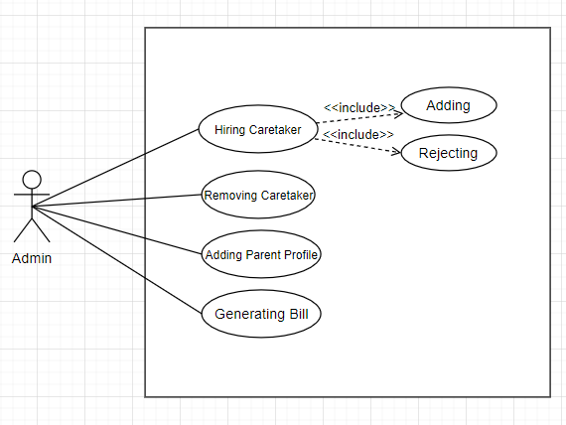
Requirements Identifying Technique
Following is the use case diagram for the Admin

Slide 18
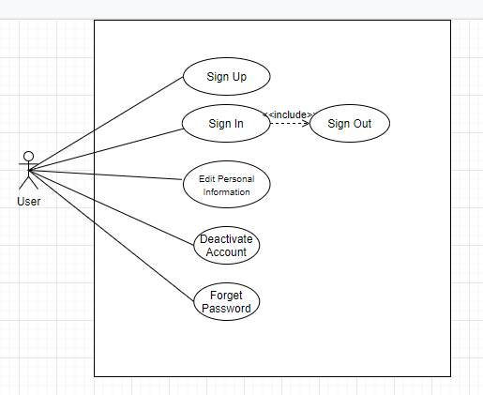
Requirements Identifying Technique
Following is the use case diagram for the users

Slide 19
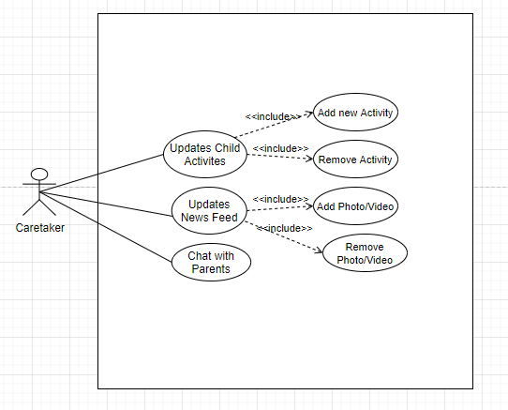
Requirements Identifying Technique
Following is the use case diagram for the caretaker

Slide 20
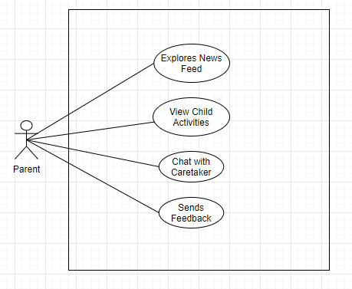
Requirements Identifying Technique (Cont.)
Following is the use case diagram for the Parent

Slide 21
Requirements Identifying Technique…
Name | Description
M1-UC: Hiring Caretaker | Admin will hire caretakers with required experience in the field
M2-UC: Sign up | User accesses the registration form mobile application to create an account on the platform
M3.1-UC: Parent dashboard | Parent will view children activities through dashboard
M3.2-UC: Caretaker dashboard | Caretaker will update children activities through dashboard
M3.3-UC: Billing dues | Parent will view the monthly dues in dashboard
M4-UC: Children activities | Caretaker will update child’s activities and parent can view it
M5-UC: Face recognition | Parents will register face for face recognition.
M6-UC: Chatbot | Parent will send messages through chat bot to know about them or to ask any questions or queries.
M7-UC: News Feed | Caretaker will upload pictures and videos and parent can view them.
M8.1-UC: Notification | Admin will send notifications to the Caretaker and parents about any latest notification.
M8.2-UC: Settings | Admin, caretaker and parent can modify the application settings accordingly.
M8.3-UC: Help | Parent or caretaker will visit help for the working of application, terms and conditions of waddler
Following are the important Use case and their descriptions
Click here to view the detailed document of Use Cases

Slide 22
Functional Requirements
Title | Requirement
M1-UC-FR: Hiring button | Admin will click on hire button
M2-UC-FR: Signup button | User will click on sign up button
M3-UC-FR: News Feed button | User will click on news feed button
M4-UC-FR: Child feed text box | Caretaker will type child feed on textbox
M5-UC-FR: Add Face button | Parent will click on add face
M6-UC-FR: Chatbot Icon | Parent will click on chatbot icon
M7-UC-FR: Add Picture button | Caretaker will click on add picture button
M8-UC-FR: Setting button | User will click on setting button
Following are the important Use case and their descriptions
Click here to view the detailed document of FRs

Slide 23
Non-Functional Requirements
Reliability
R1: System will be available 24/7 and will be available to the user at any time.
R2: Our system will also provide the user to view and update any information in our application at any time.
R3: All significant bugs will be removed from the system. If any kind of bugs is left off, they will be minor, meaning they will not cause any hindrance during the usability of the application.
2. Usability
USE-1: Any man who does not have used any application before will understand the interface.
USE-2: Any man with basic knowledge will understand the usages of application within few minutes.
USE-3: If the user got any error, he would complain about it in the feedback section.

Slide 24
Non-Functional Requirements
3. Performance
PER-1: The parent will be able to check any updates within few sec.
PER-2: The updating activities and uploading pictures/videos on the application will take time depending upon the data. As it will be going on to the server, it will take some time.
PER-3: The system will notify the caretaker as the video/picture gets uploaded.
PER-4: After uploading, the parent can easily view pictures and videos of their child performing activities within seconds depending upon the internet connection speed.
4. Security
SR1: The system will ensure that only valid user will access the application—those that have a valid e-mail and password.
SR2: System will protect the fundamental privacy rights of every user. The system will explicitly ask the user about the things he wants to share with his friends.

Slide 25
External Interface Requirements
Software Interfaces
Mobile phone camera would be used for face recognition.
2. Communication Interfaces
An email will be used to notify the user about the selection of him/her into the system mean it will describe the user as “Dear Mr./Mrs.name profile had been added into the system, please login for further instructions, Waddler”.

Slide 26
Conclusion
The application will be very useful and helpful in gathering the information and helping parents by getting them live update what their kids are doing and for caretakers as well. Parents will be able to get all record of the week. Caretaker will also find it convenient by updating the tasks for the day just by clicking on the app and giving updates to every parent of their kids

Slide 27
References
https://www.researchgate.net/publication/283784170_The_Childcare_Center_How_to_Ensure_Quality_Childcare_Practices
https://www.oreilly.com/library/view/machine-learning-pocket/9781492047537/
https://link.springer.com/article/10.1023/A:1016609927849
https://www.oreilly.com/library/view/learning-react-native/9781491929049/ch01.html
Research Advances in Face Recognition - IEEE Conference Publication
Study of Face Recognition Techniques: A Survey (thesai.org)

